Slide 1
C/C++ Programming Tools
Parallel Programming Lab2-1
Oct 20 2022

Slide 2


Compilers
GCC family
gcc
g++
LLVM/Clang family
clang
clang++

Slide 3
GCC vs Clang
They have mostly the same usage
Flags (options) supported on one should mostly work out-of-the-box on the other
Initially Clang put a lot of effort on providing better error messages, and but now GCC has catched on
We suggest trying to use Clang if you cannot understand GCC’s error messages, and vice versa.
Also they sometimes produce faster executables than each other.

Slide 4
MPI Compiler Wrapper
mpicc calls gcc under the hood
mpicxx calls g++ under the hood
To use mpicc with clang, call mpicc -cc=clang
To use mpicxx with clang++, call mpicxx -cxx=clang++

Slide 5
GCC/Clang optimization flags
-O2
Turns on most optimizations
-O3
Turns on all optimizations in -O2, plus optimizations that trade off code size for execution time
https://gcc.gnu.org/onlinedocs/gcc/Optimize-Options.html

Slide 6
GCC/Clang other flags
-lXXX Link the XXX library. For example, -lm links the math library libm.so mpicc automatically adds -lmpi for you
-o XXX Set the output executable filename to XXX
-g Generate debug information

Slide 7
Makefile

Slide 8
Makefile: a very brief introduction
Used to tell the make command how to build executables from sources.

Slide 9
Makefile
We acknowledge make is not a good build system
But it’s most commonly used / known
So as an unfortunate outcome, we still use Makefiles
We ask you to submit Makefiles in homeworks because we encourage you to try different compiler options

Slide 10
Example
- Makefile rule format
target: requirements
command
- .PHONY : specify phony target
$ make (= make all)
gcc -o hello -O3 hello.c
gcc -o world -O3 world.c
$ make clean
rm -f hello world
.PHONY: all all: hello world
hello: hello.c gcc -o hello -O3 hello.c
world: world.c gcc -o world -O3 world.c
.PHONY: clean clean: rm -f hello world

Slide 11
Example
- Variable
- % : stem part
- $@ : the target
- $^ : all requirements
- $< : the first requirement
TARGETS = hello world
.PHONY: all all: $(TARGETS)
%: %.c gcc -o $@ -O3 $<
.PHONY: clean clean: rm -f $(TARGETS)

Slide 12
Example
CC = gcc CFLAGS = -O3
TARGETS = hello world
.PHONY: all all: $(TARGETS)
%: %.c $(CC) -o $@ $(CFLAGS) $<
.PHONY: clean clean: rm -f $(TARGETS)

Slide 13
Example
CC = gcc
CFLAGS = -O3
TARGETS = hello world
.PHONY: all all: $(TARGETS)
.PHONY: clean clean: rm -f $(TARGETS)

Slide 14
2. Debugging Tools

Slide 15
Debugging Tools
Turn on compiler warnings
AddressSanitizer
Clang static analyzer
Study by yourself
gdb
Using this in parallel environments is super complex so we’re not going to cover it

Slide 16
Turn on compiler warnings
Just add -Wall to the list of compiler flags

Slide 17
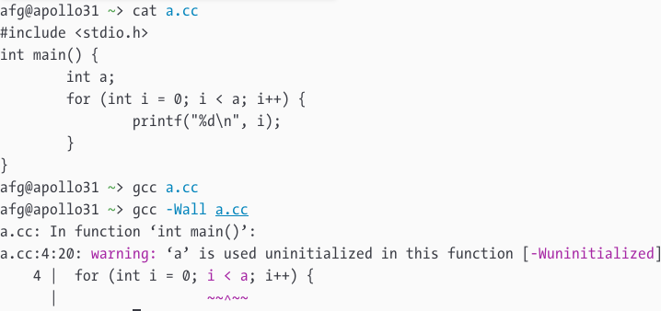
Compiler warnings off vs on

Slide 18
AddressSanitizer
Asks the compiler to inject code to check memory access during execution.
https://github.com/google/sanitizers/wiki/AddressSanitizer

Slide 19
AddressSanitizer
Add -fsanitize=address -g to the compiler. Then run your code as usual. Asan will crash your program if something wrong happened.
AddressSanitizer works with either GCC or Clang.
Enabling Asan would harm performance! Only use it for debugging, don’t submit your code with Asan enabled.

Slide 20
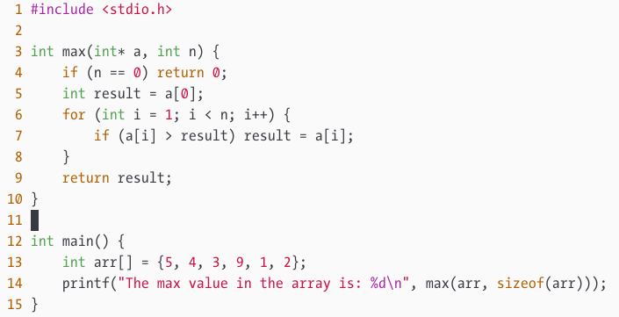

Slide 21
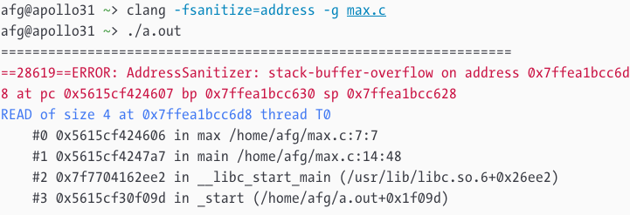

Slide 23
sizeof(arr) / sizeof(int)

Slide 24
Study by yourself

Slide 25
Clang static analyzer
Perform more complex compile-time static analysis than -Wall

Slide 26
Clang static analyzer: usage
Use one of the following
Compile with clang --analyze
Use scan-build -o outputpath make instead of make
Then, you can either:
Run scan-view --host 0.0.0.0 --allow-all-host outputpath/XXX
Or download outputpath/XXX and view locally

Slide 27
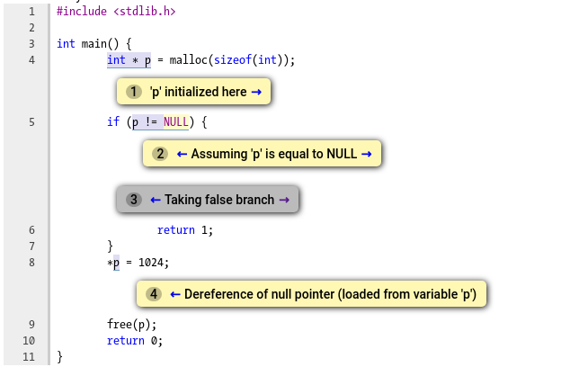

Slide 28
